Slide 1
Search Final Presentation
Ahmed Al Marzook - Task 1.1
Abhishek Babuji - Task 1.2
Jay Kaiser - Task 2
Jinsu Kim - Task 2

Slide 2
Task 1, Part 1: Index Search Using Apache Lucene
All reviews and tips for each business in Toronto, ON were respectively concatenated and input into a Lucene index.
For a given user u:
We collected all reviews r and tips t written by u.
A single query was constructed from these.
5 | 4 | 3 | 2 | 1
r * 3 | r * 2 | r | r * -2 | r * -3

Slide 3
Task 1, Part 1: Index Search Using Apache Lucene
(q = r₅ ∩ r₄ ∩ r₃ ∩ r₂ ∩ r₁ ∩ t) was searched in the Toronto index.
The top ten most similar businesses in the index were extracted.

Slide 4
Mock Example of our Process
Evaluation:
Created mock dataset similar to the actual data with 10 entries.
The dataset files that were created: business.json, review.json, tip.json.
All files were created manually with random inputs.

Slide 5
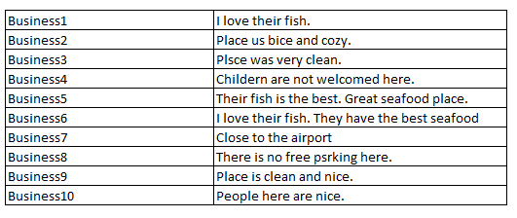
We created 10 business named like business1, business2, business3 …… business10
We created 10 reviews for the business:

Slide 6
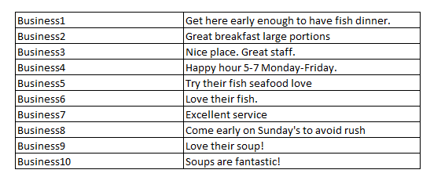
We created 10 tips for the business:

Slide 7
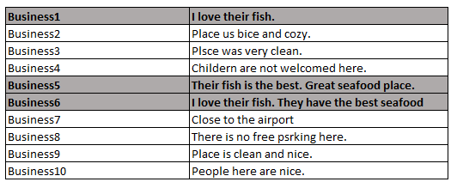
We created mock user:
Businesses review

Slide 8
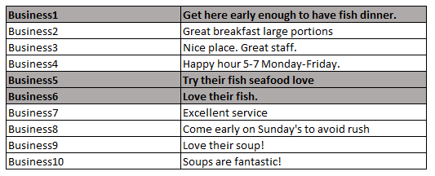
We created mock user:
Businesses tips

Slide 9
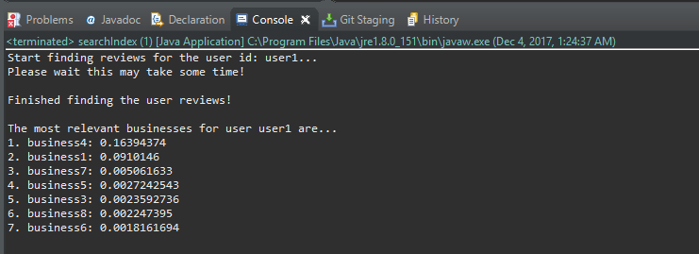
Mock Evaluation Output

Slide 10
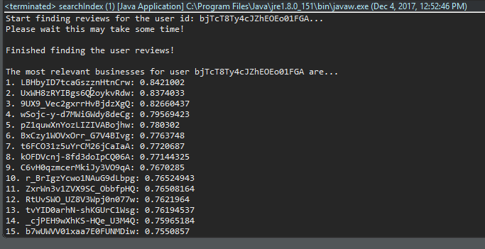
Actual Example of Output

Slide 11
Task 1, Part 2: Collaborative Filtering Using Apache Mahout
Both user based and item based collaborative filtering approaches were tried.
A combination of similarity metrics and training/test sizes along with a a variety of neighborhood sizes were tried.
The best approach was then used based on the chosen evaluation metric.

Slide 12
Task 1, Part 2: User Based Collaborative Filtering Overview
Look for users who share the same rating patterns with the active user (the user whom the prediction is for).
Use the ratings from those like-minded users found in step 1 to calculate a prediction for the active user
This falls under the category of user-based collaborative filtering. A specific application of this is the user-based Nearest Neighbor algorithm.

Slide 13
Task 1, Part 2: Item Based Collaborative Filtering Overview
Item-based collaborative filtering (users who bought x also bought y), proceeds in an item-centric manner:
Build an item-item matrix determining relationships between pairs of items
Infer the tastes of the current user by examining the matrix and matching that user's data

Slide 14
User Based Similarity Metrics
UserSimilarity similarity = new PearsonCorrelationSimilarity(model);
UserSimilarity similarity = new LogLikelihoodSimilarity(model);
UserSimilarity similarity = new TanimotoCoefficientSimilarity(model);
UserSimilarity similarity = new EuclideanDistanceSimilarity(model);
UserSimilarity similarity = new SpearmanCorrelationSimilarity(model);

Slide 15
Item Based Similarity Metrics
ItemSimilarity similarity = new PearsonCorrelationSimilarity(model);
ItemSimilarity similarity = new LogLikelihoodSimilarity(model);
ItemSimilarity similarity = new TanimotoCoefficientSimilarity(model);
ItemSimilarity similarity = new EuclideanDistanceSimilarity(model);

Slide 16
Available Evaluation Metrics
MAE/Average Absolute Difference: For each rating- prediction pair, their absolute error is calculated. After summing up these pairs and dividing them by the total number of rating-prediction pairs, Mean Absolute Error can be found. It is the most commonly used and can be interpret easily.
RMSE: This is a statistical accuracy metric that is slightly different from Mean Absolute Error. Once rating-prediction difference is calculated, its power of 2 is taken. After summing them up and dividing them by the total number of rating-prediction pairs and taking square root of it, Root Mean Square Error can be found.
Precision: Depends on the recommendations made.
Recall: Depends on the recommendations made.

Slide 17
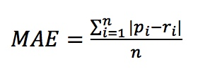
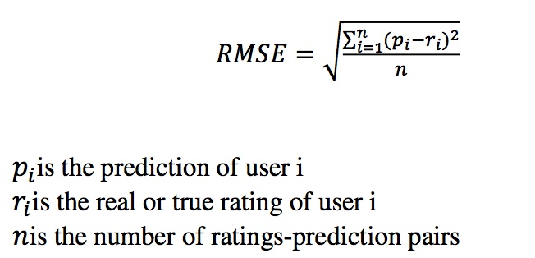
Evaluation Metrics Considered

Slide 18
The input to Mahout
The user_id, rating and the business_id of all associated businesses in the city of Champaign, Illinois.
The data was parsed from .json and converted to .csv so DataFrames could handle them.
Left join was performed on the review.csv and the business.csv and filtered in a way that only the categories containing the ‘RESTAURANTS’ we considered.
Every user_id and business_id were then factorized and represented by unique integers (which is the format Apache Mahout wants it in.
A separate .csv file for the user_id’s alone were also stored so Mahout can print a certain number of recommendations for each user_id.

Slide 19
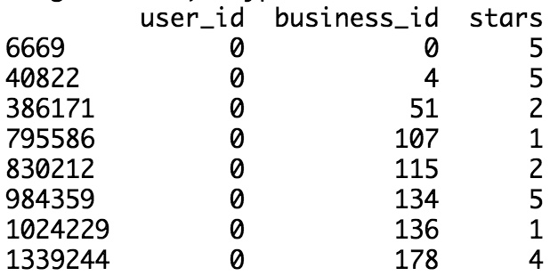
The input to Mahout

Slide 20
Analysis!
(Lots and lots of graphs, brace yourselves!)

Slide 21
Nearest Neighbors vs. Root Mean Squared in User Based

Slide 22
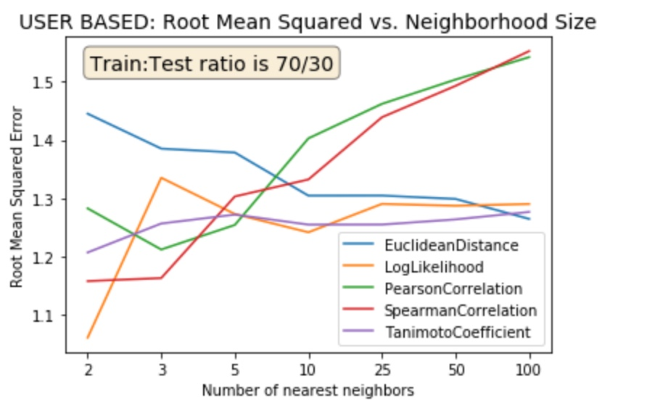

Slide 23
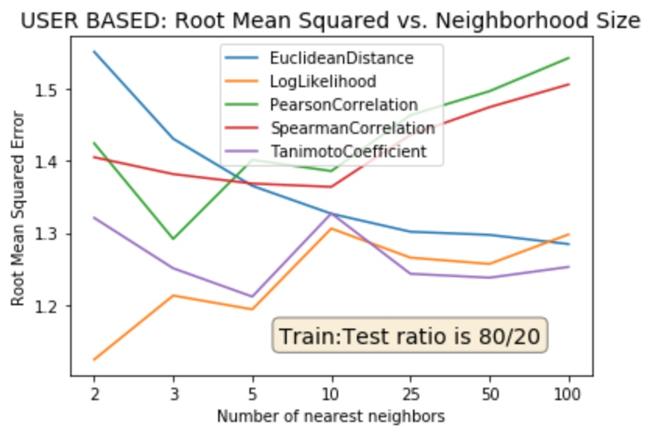

Slide 24
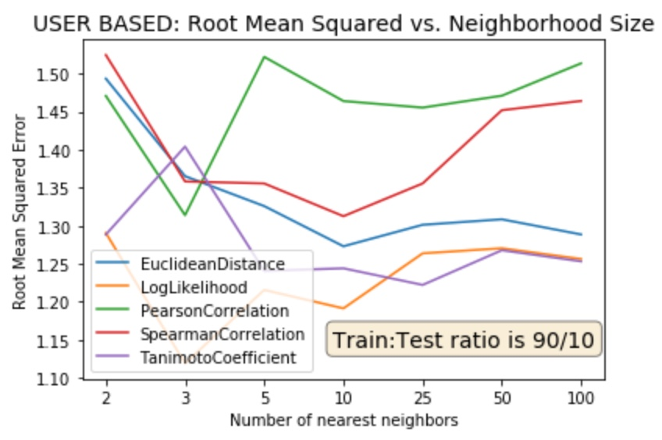

Slide 25
Nearest Neighbors vs. Mean Absolute Error in User Based

Slide 26
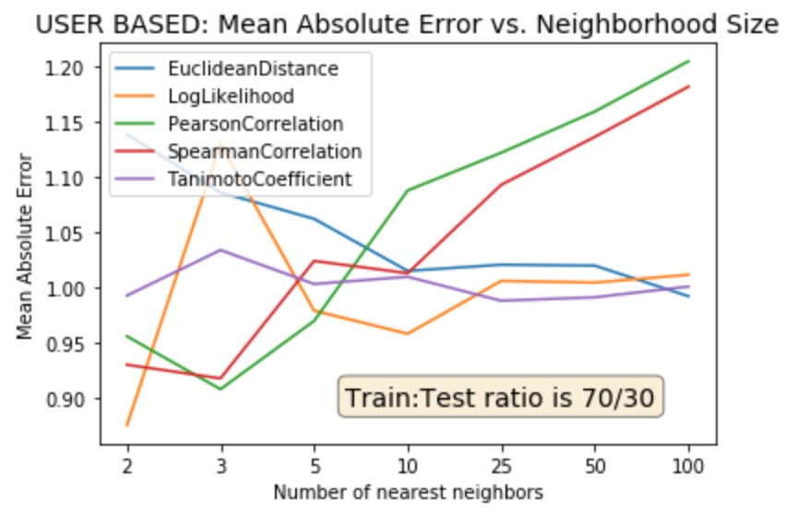

Slide 27
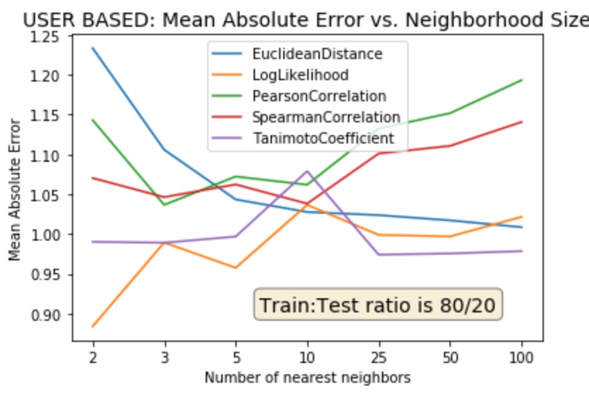

Slide 28
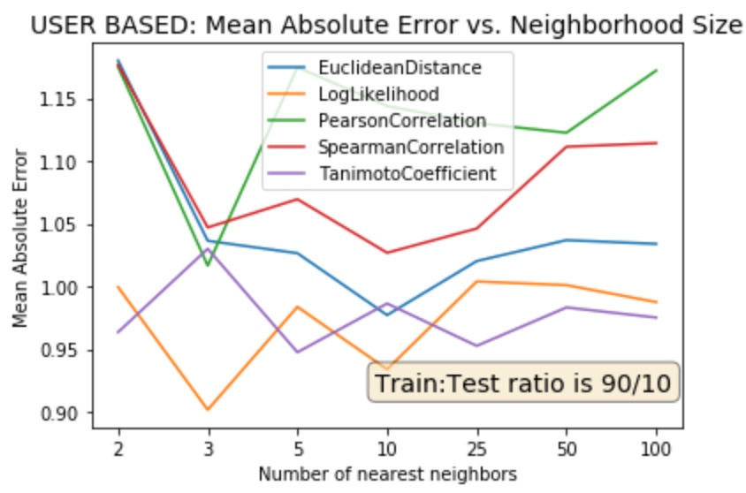

Slide 29
Size of Training Set vs. Root Mean Squared Error

Slide 30
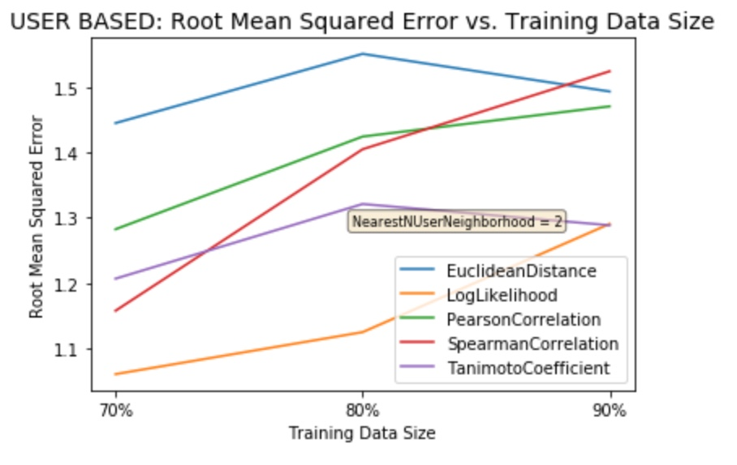

Slide 31
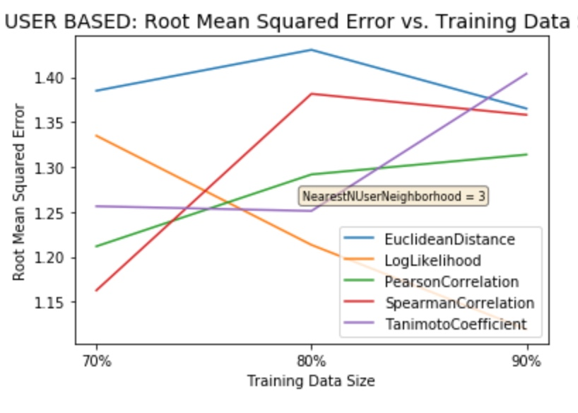

Slide 32
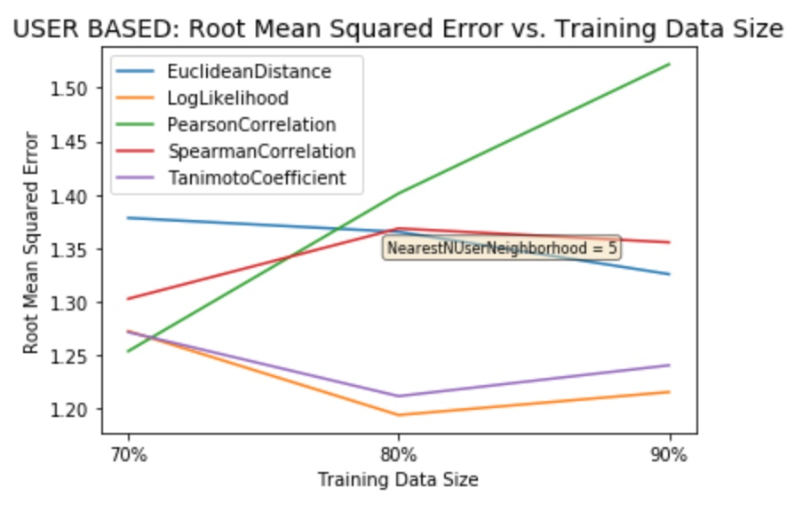

Slide 33
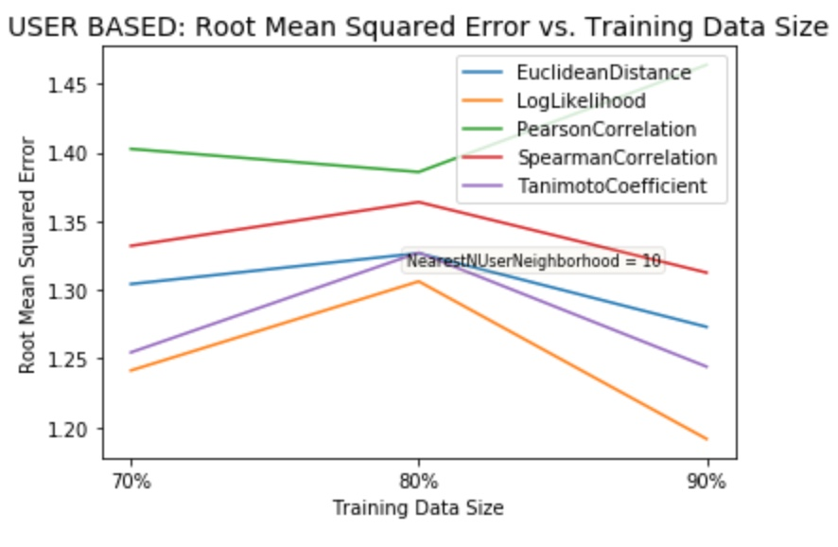

Slide 34
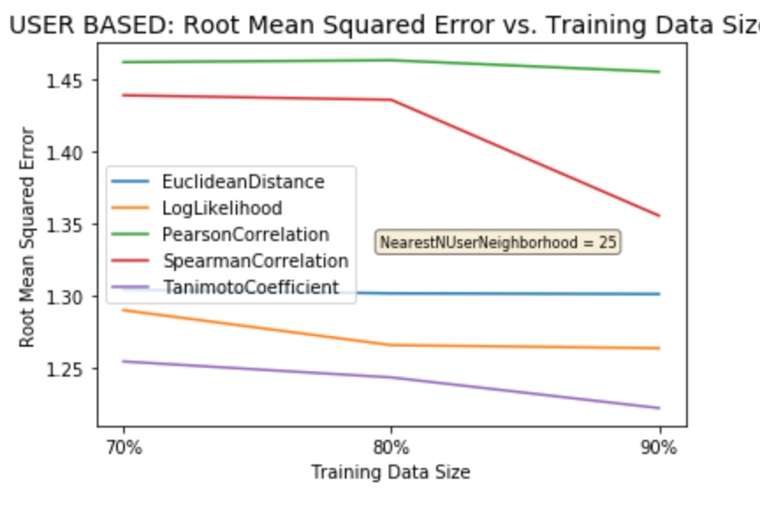

Slide 35
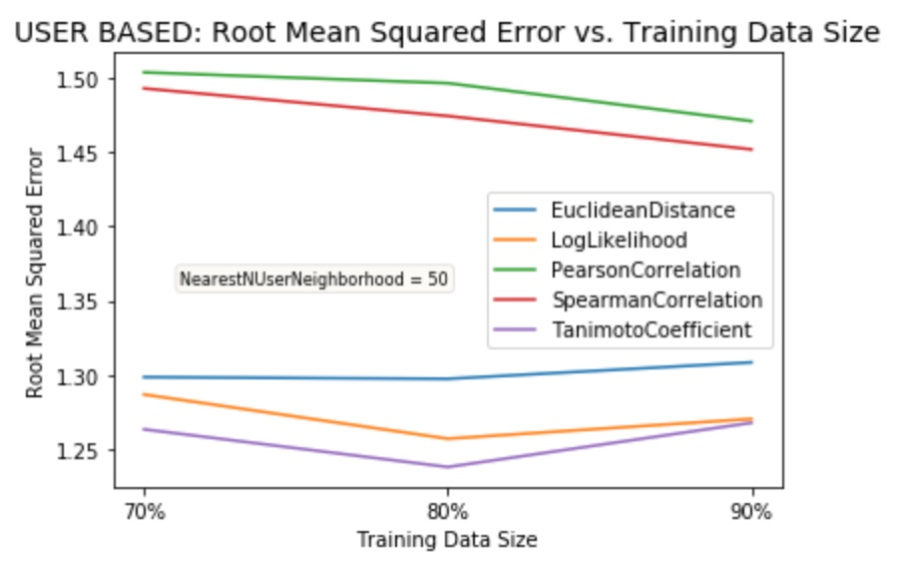

Slide 36
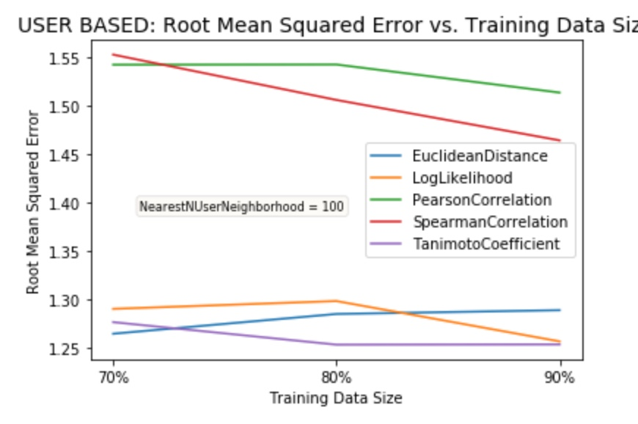

Slide 37
You know the drill... We saw RMSE changes, now MAE changes..

Slide 38
User vs. Item Based Analysis

Slide 39
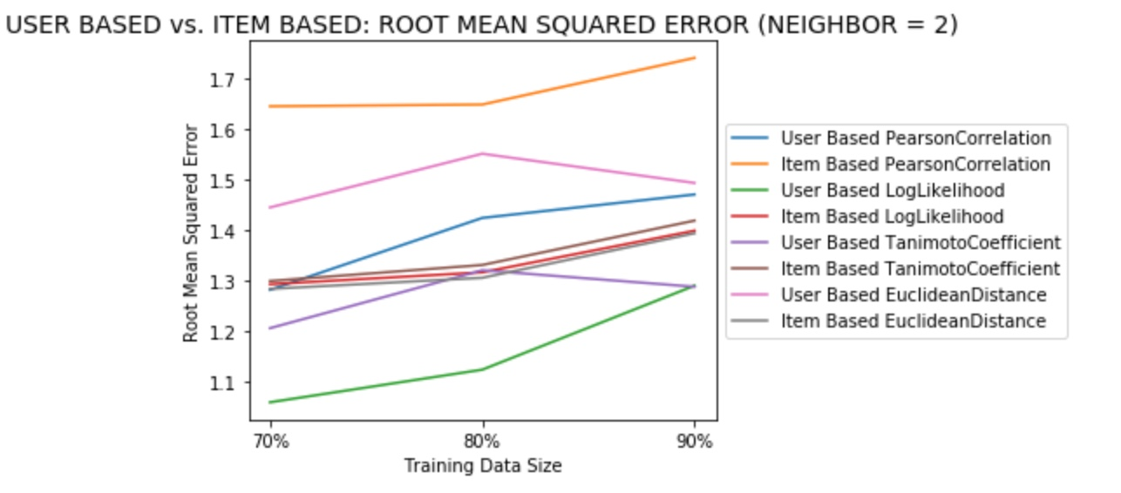

Slide 40
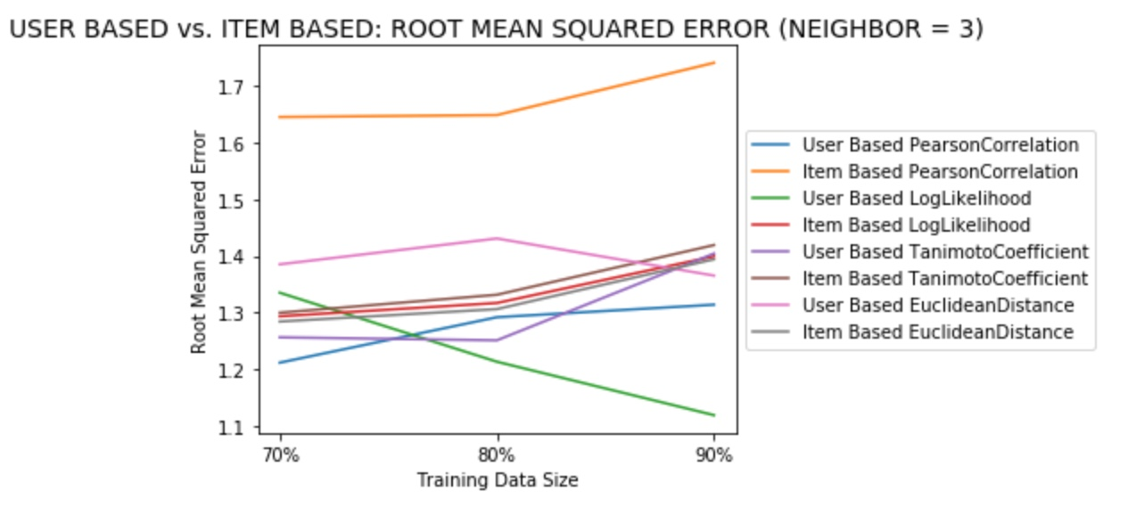

Slide 41
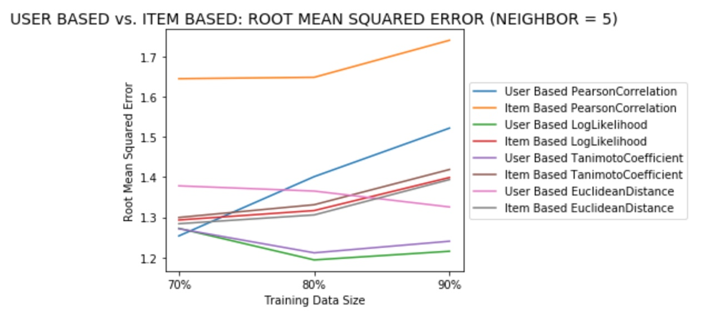

Slide 42
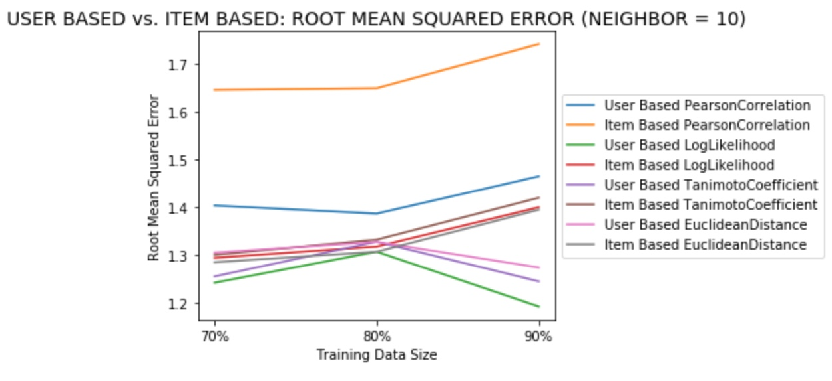

Slide 43
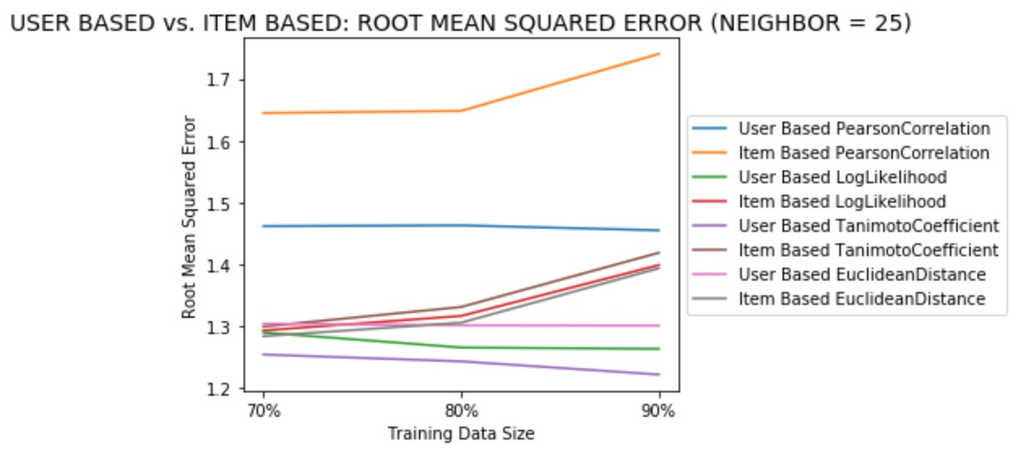

Slide 44
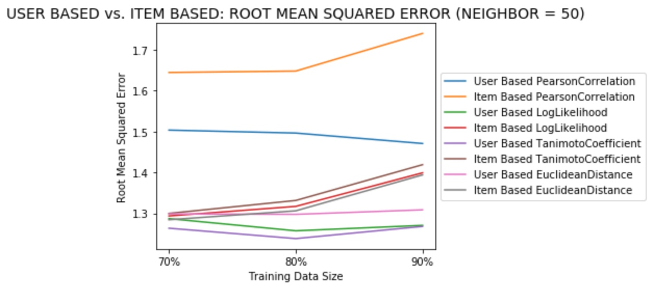

Slide 45
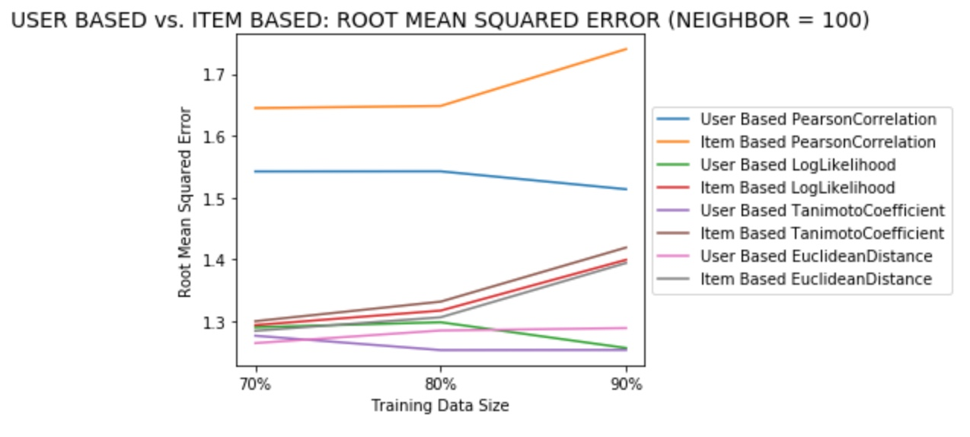

Slide 46
Conclusion
User Based: TanimotoCoefficient Similarity with 100 neighbors was used to print 3 reviews for each of the user_id.

Slide 47
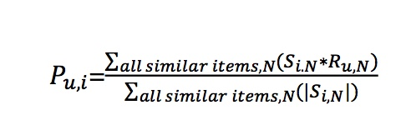
Rating Prediction
For item i and user u, find sum of the rates to user u on the items similar to i using the chosen similarity metric.

Slide 48
References
COMPARISON OF COLLABORATIVE FILTERING ALGORITHMS WITH VARIOUS SIMILARITY MEASURES FOR MOVIE RECOMMENDATION
Taner Arsan, Efecan Köksal, Zeki Bozkuş
Department of Computer Engineering, Kadir Has University, Istanbul, Turkey

Slide 49

Other sources

Slide 50
Task 2
Can we find evidence of economic change via Yelp reviews?
Does the economy affect people’s habits enough to be seen in review data?

Slide 51
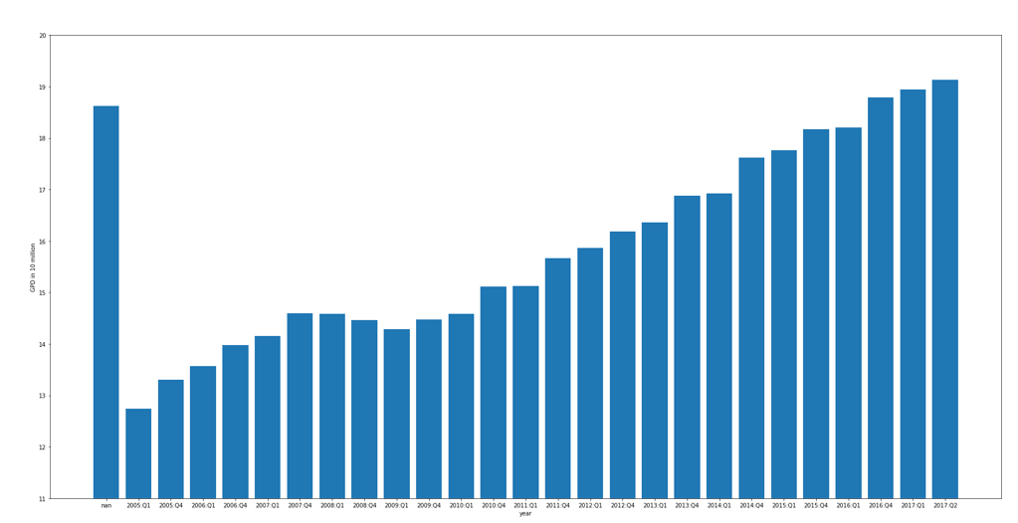
Overall GDP

Slide 52
Five hypotheses…
The number of reviews will fluctuate respective to the economy.
The number of negative reviews will fluctuate respective to the economy.
Mentions of economically-salient words (e.g. “cheap”, “generous”, “expensive”) will be more common in reviews during economic hardship.
Visits to low-end businesses and high-end businesses will inversely fluctuate respective to the economy.
Cities hit harder during times of economic hardship will experience more extreme variations of hypotheses 1-4 than cities less hit.

Slide 53
Methods
Individual reviews were extracted for every state and major city in the dataset.
To account for number of users influencing the number of reviews, each hypothesis was normalized based on the number of reviewers or reviews per city/state.
Pearson correlations need to be run between economic data and the results of our analysis to verify for sure.

Slide 54
Hypothesis 1
(The number of reviews will fluctuate respective to the economy.)
When people do not have money to spend, they are less likely to go out and therefore less likely to create a review for a business.

Slide 55
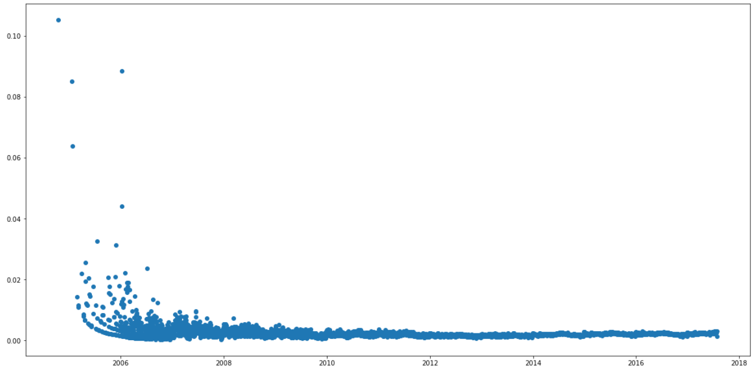
Nevada

Slide 56
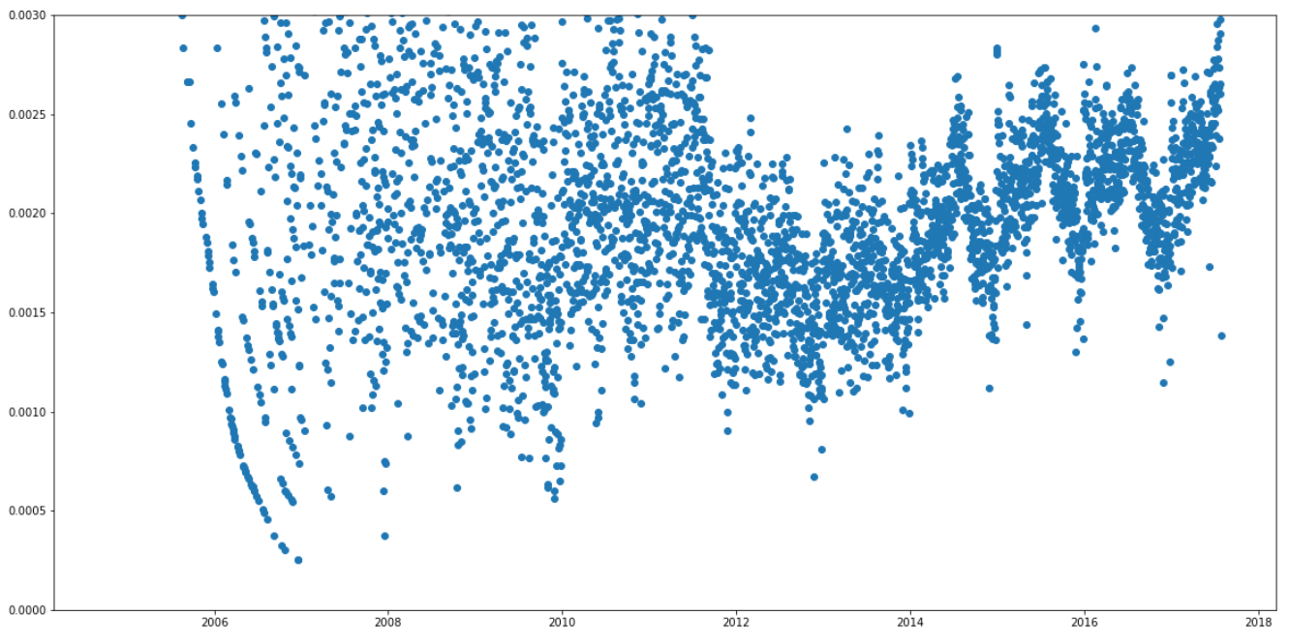
Nevada (number of reviews per user)

Slide 57
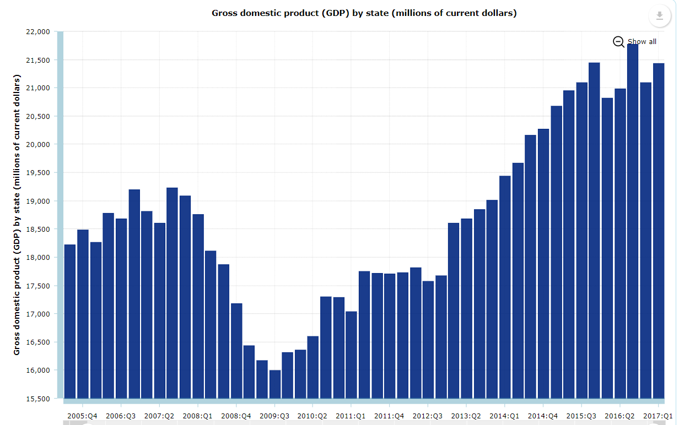
Nevada (accommodation and food service)

Slide 58
Nevada (number of reviews per user)

Slide 59
Hypothesis 2
(The number of negative reviews will fluctuate respective to the economy.)
During times of economic hardship, money is less-freely able to be spent, so bad experiences will be seen as a greater waste than during economic prosperity.

Slide 60
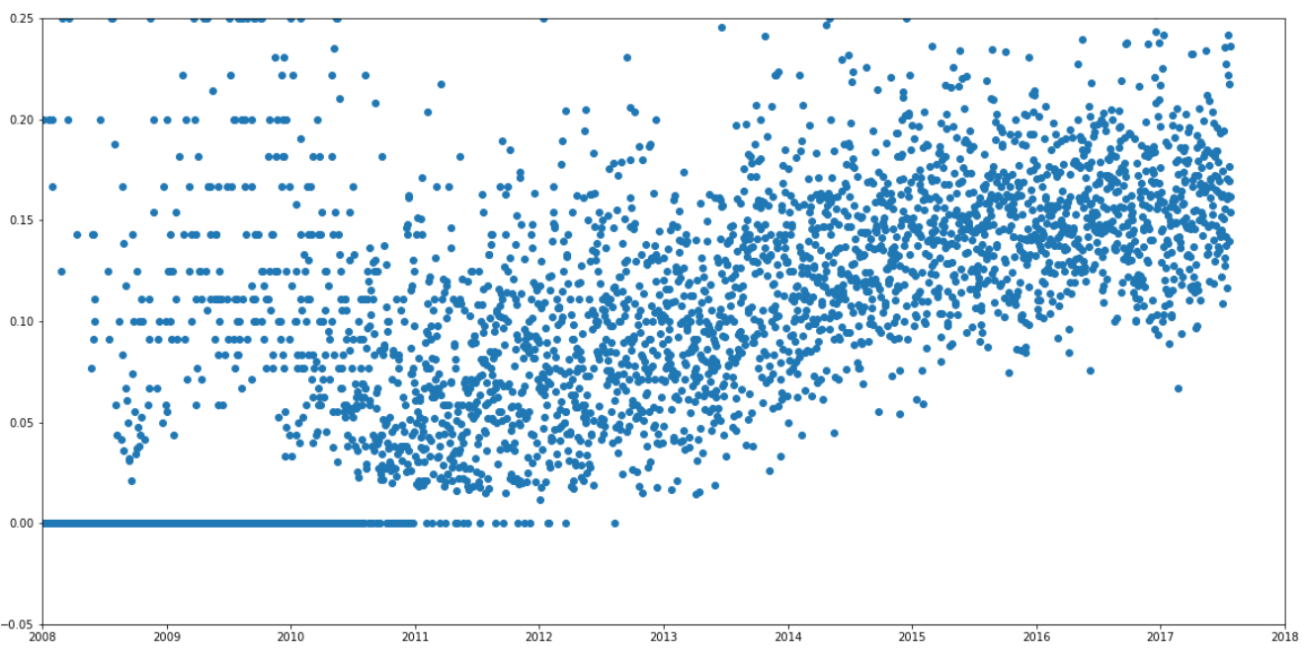
North Carolina (1 star reviews)

Slide 61
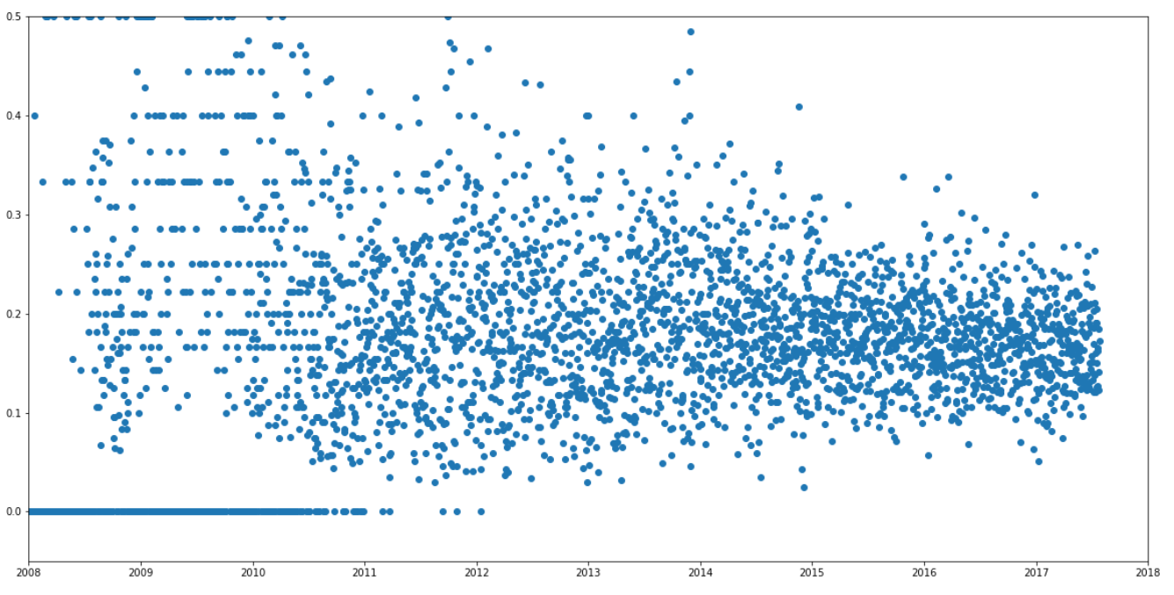
North Carolina (2 star reviews)

Slide 62
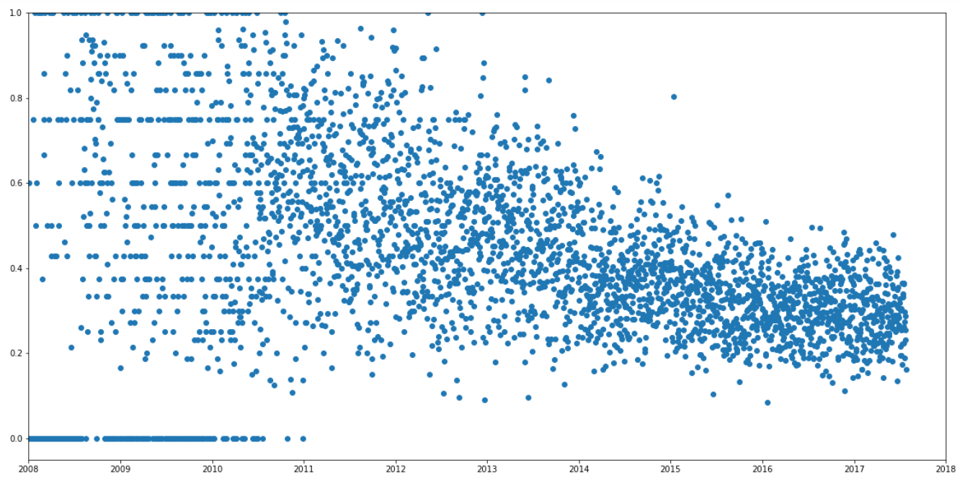
North Carolina (3 star reviews)

Slide 63
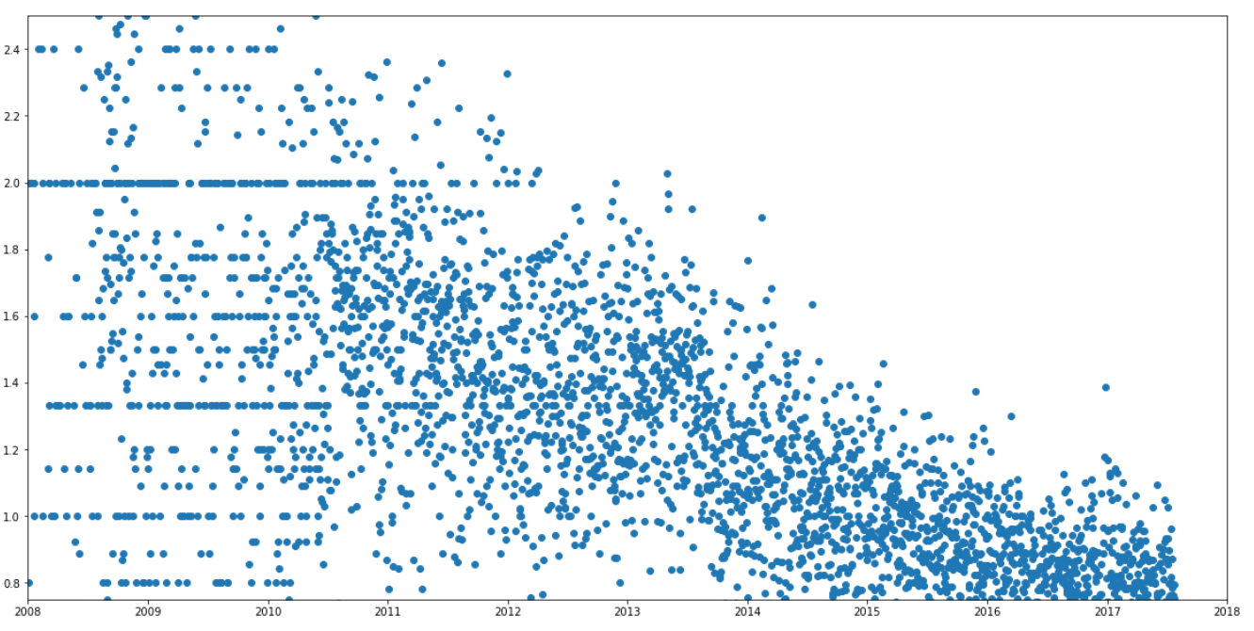
North Carolina (4 star reviews)

Slide 64
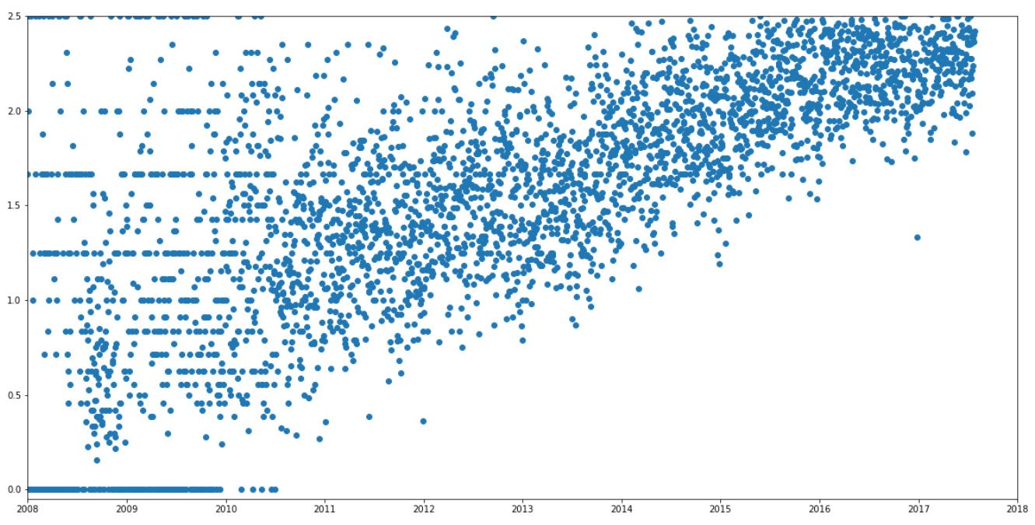
North Carolina (5 star reviews)

Slide 65
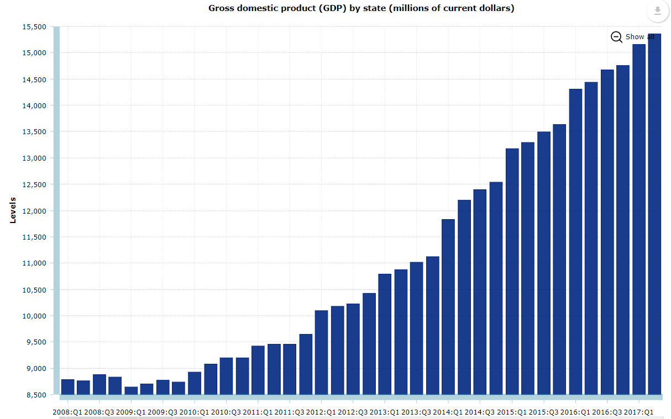
North Carolina (accommodation and food service)

Slide 66
Hypothesis 3
(Mentions of economically-salient words will be more common in reviews during economic hardship.)
When money is scant, larger (or smaller) portion sizes for the price will be greater (and less) appreciated.
“Portions are (not) small/generous/measly/large.”,
“Food is expensive/cheap/great deal.”

Slide 67
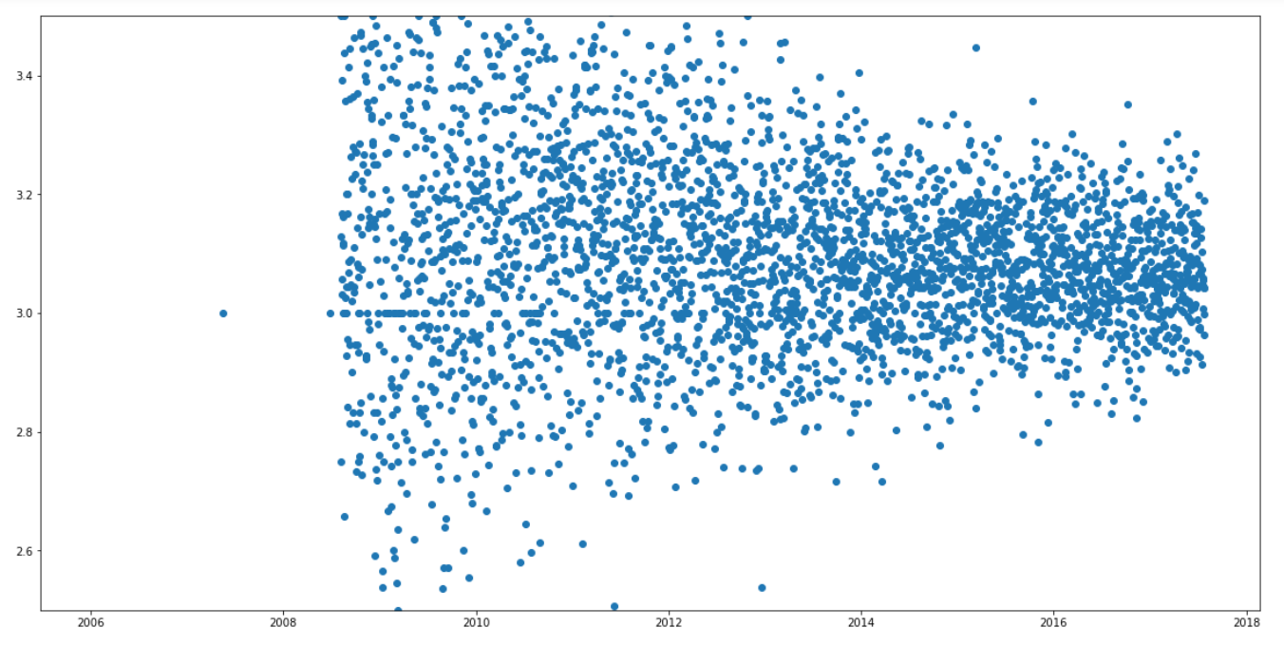
Ontario (reviews w/ mention of terms)

Slide 68
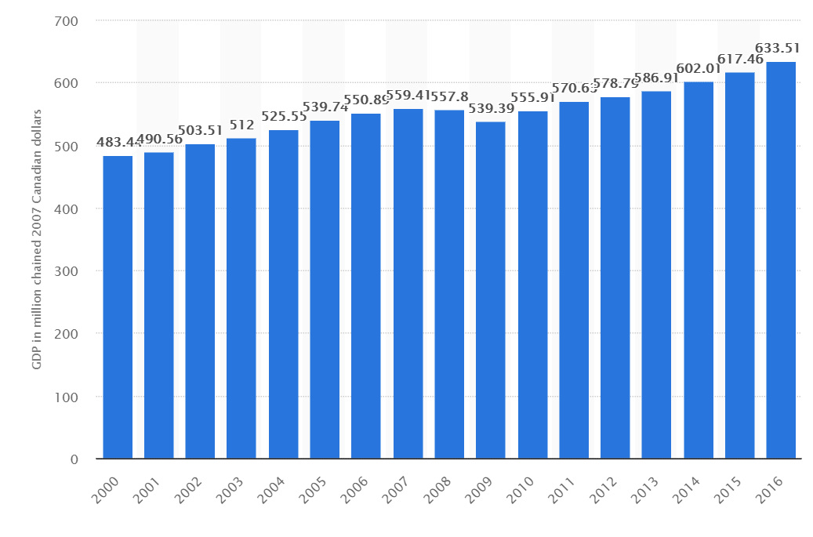
Ontario (GDP)

Slide 69
Hypothesis 4
(Visits to low-end businesses and high-end businesses will inversely fluctuate respective to the economy.)
e.g. If an individual wants hamburgers for dinner, but doesn’t have the money to spend, they’re more likely to go to McDonald’s than to Red Robin.
McDonald’s, Wendy’s Burger King, Subway, Jimmy John’s
Red Lobster, Outback Steakhouse, Texas Roadhouse, Red Robin

Slide 70
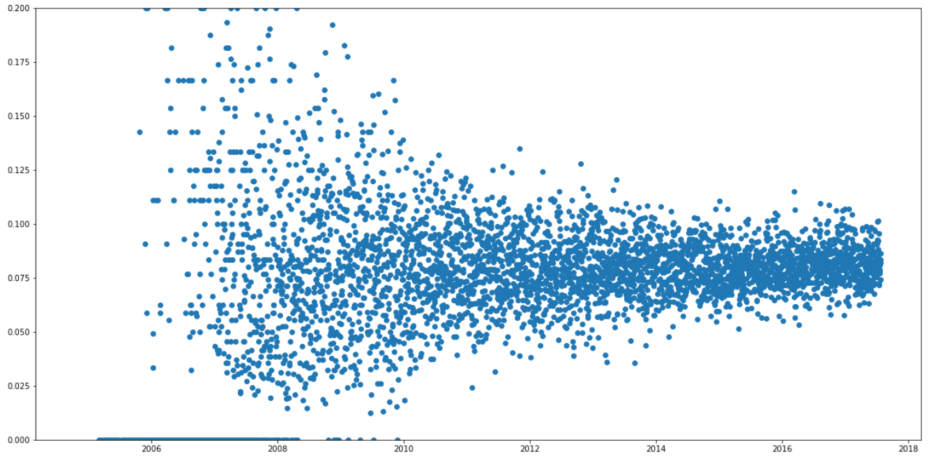
Nevada (low-end businesses)

Slide 71
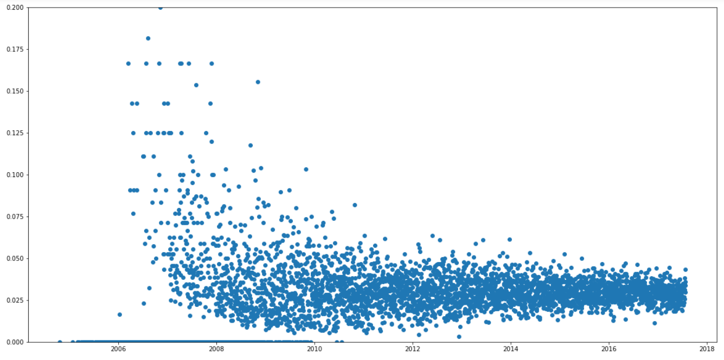
Nevada (high-end businesses)

Slide 72
Nevada (accommodation and food service)

Slide 73
Hypothesis 5
(Cities hit harder during times of economic hardship will experience more extreme variations of hypotheses 1-4 than cities less hit.)
In cities harder hit by the economy, the difficulties experienced by citizens that have been mentioned above will be expounded.

Slide 74
Nevada (number of reviews per user)

Slide 75
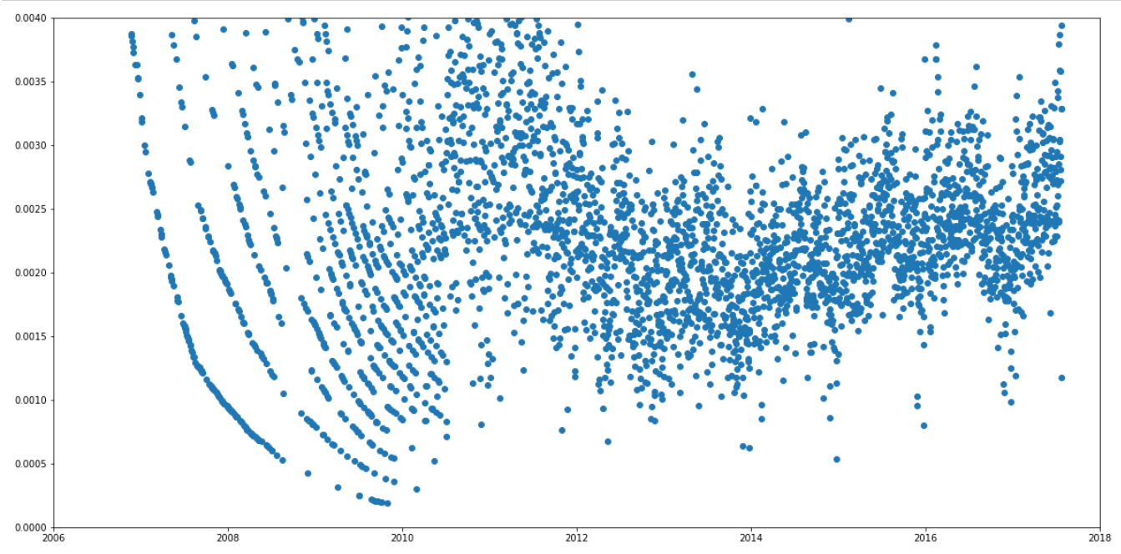
North Carolina (number of reviews per user)

Slide 76
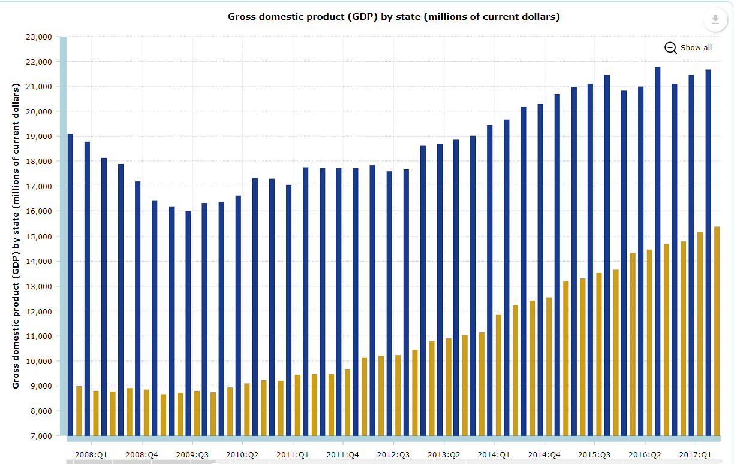
Nevada vs North Carolina (accommodation…)

Slide 77
Conclusions
Based on our limited data, we cannot find any relationship between economic trends and Yelp review data.
No drastic economic changes have happened since the recession of 2008.
Correlation tests need to be run to confirm whether or not any of the data matches economic trends.
Data is too limited to prove the efficacy of Hypotheses 2-4.

Slide 78
Limitations
The dataset is surprisingly small.
Cities that we wanted to test (e.g. Oklahoma City and Detroit) were not found in the data.
Reviews really only start after 2008, so a comparison from before and after the recession cannot easily be made.
It is difficult to find an accurate means to normalize the change in reviews given a change of users as opposed to a change in the economy.

Slide 79
Future Work
Include larger dataset
Work on actual Yelp data including larger cities with larger quantities of reviews
Use other resources that can have a wider range of time
Better comparison before and after economic recession
Extract Twitter data that include restaurants’ reviews
Sentiment analysis on review data before and after the recession

Slide 80
References
Bureau of Economic Analysis (https://www.bea.gov/index.htm)
Bureau of Labor Statistics (https://www.bls.gov/lau/)
Antenucci et al. (2014). Using Social Media to Measure Labor Market Flows. NBER Working Paper.
Arias et al. (2016). Metro business cycles. Journal of Urban Economics. 94, 90-108.

Slide 81
Thanks!

